Slide 1
QCC Student Readiness
Various forms of assistance in Mathematics: Courses and Labs and Mentors and Tutors: Joseph Bertorelli, Chairperson , Department of Mathematics and Computer Sciences
How does this program work? How are students placed into this program? What are the results thus far? Any plans for changes in the near future?

Slide 2
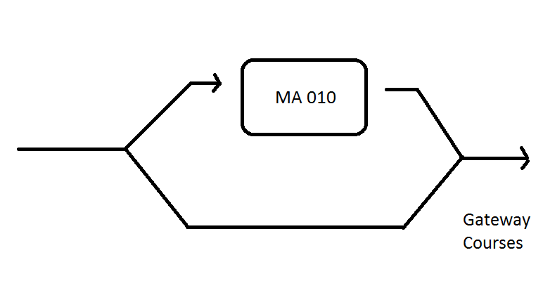
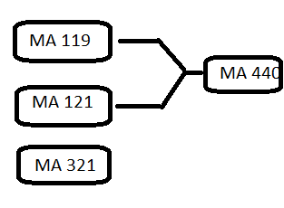
Initial Placement

Slide 3
Placement
Most students are placed by the results on the entrance CUNY Assessment Test in Mathematics.
M2 score of >= 40 , exempt from MA 010*
M3 score of >= 55 , exempt from MA 119
M5 score of >= 30 , exempt from MA 121
* 2 years of Regents mathematics with one score of 80 or above, SAT score of 500 also exempt a student from MA 010.

Slide 4
Math Placement Test Results
Math Placement Test Results
Full- and Part-Time Freshmen
Fall Cohort | Exempt from Testing | Passed | Failed | Not Tested | Total | Total Tested or Exempt
 |  |  |  |  |  | N | Passed or Exempt | Need Remedi-ation
Fall '08 | 31.3% | 10.2% | 47.6% | 11.0% | 2,744 | 2,443 | 46.6% | 53.4%
Fall '09 | 36.4% | 10.2% | 48.0% | 5.5% | 3,705 | 3,503 | 49.3% | 50.7%
Fall '10 | 30.7% | 10.8% | 50.7% | 7.8% | 3,209 | 2,958 | 45.0% | 55.0%
Fall '11 | 20.8% | 8.7% | 63.8% | 6.7% | 3,934 | 3,669 | 31.6% | 68.4%
Fall '12 | 18.4% | 10.2% | 64.9% | 6.5% | 3,335 | 3,119 | 30.6% | 69.4%
Fall '13 | 18.0% | 12.0% | 63.5% | 6.5% | 3,396 | 3,174 | 32.1% | 67.9%
Fall '14 | 12.4% | 16.2% | 66.4% | 5.1% | 3,392 | 2,849 | 30.0% | 70.0%
¹Based on initial test results prior to any summer interventions preceding first fall.
Source: CUNY IRDB

Slide 5
Passing Rates in MA 010
Fall 2013
Comprehensive John Jay | 49.8 | 46.6 | 40.0 | 40.0* | ---
Medgar Evers | 23.2 | 24.9 | 30.7 | 28.4 | 28.9
NYCCT | 30.3 | 28.1 | 37.0 | 33.9 | 20.2
Staten Island | 31.7 | 32.9 | 46.5 | 38.2 | 48.4
Comprehensive College Average | 32.1 | 30.2 | 37.7 | 34.4 | 32.6
Community BMCC | 31.9 | 32.3 | 46.6 | 33.3 | 39.4
Bronx | 29.7 | 20.7 | 38.3 | 39.9 | 42.3
Guttman | --- | --- | --- | --- | ---
Hostos | 30.8 | 31.3 | 49.9 | 33.5 | 41.0
Kingsborough | 25.6 | 32.8 | 39.8 | 50.7 | 54.4
LaGuardia | 29.9 | 30.9 | 37.8 | 42.0 | 42.4
Queensborough | 24.7 | 25.8 | 42.0 | 36.7 | 41.5
Community College Average | 29.0 | 29.4 | 42.6 | 38.8 | 42.8
University Average | 29.7 | 29.6 | 41.7 | 38.0 | 40.5

Slide 6
USIP Interventions – Summer 2014
Course | Course Title | Pass Rate
BE 11 | Writing Workshop | 50%
BE12 | Reading Workshop | 66%
BE16 | Intensive Advanced Reading | 57%
BE17* | Immersion Write Repeats | 29%
BE18 | Immersion Read Repeats | 33%
BE20* | Usip For Be111/121 Students | 30%
BE21* | Usip For Be112/122 Students | 40%
BE22 | Usip For Be203/225 | 21%
BE23* | Usip For Be205/226 | 39%
MA10* | Elem Algebra | 58%
LimeSpring | Elem Algebra - experimental program | 71%

Slide 7
REMEDIAL MATH WORKSHOP PILOT PROJECT
January 2015
The Remedial Math Workshop was designed to increase the number of MA-10 multiple repeaters (failed MA-10 two or more times) and first-time repeaters (failed once and scored at least 52 on the CEAFE) who successfully complete MA-10.

Slide 8
Results of the Workshop
Population | Number Attended | Passed CEAFE | Passed MA 010
All students | 69 | 97% | 96%
Multiple Repeaters | 31 | 94% | 90%
Almost passed CEAFE | 38 | 100% | 100%

Slide 9
Mathematics Learning Center
July – August 2014 MA 10 USIP Immersion; n= 506 | Passed ( 60 or Better) | Scored greater than or equal to 80 | Scored greater than or equal to 90
CEAFE | 76% | 49% | 25%
January 2015 – MA 10 USIP Immersion; n= 42 | Passed (60 or Better) | Scored greater than or equal to 80 | Scored greater than or equal to 90
CEAFE | 90% | 74% | 48%
The Mathematics Learning Center will use S218 to offer more computer technology based tutoring and workshops.
In addition, the Math Center will offer more workshops to fulfill the requests for student services.

Slide 10
Any plans for changes in the near future?
July USIP for new students
Current – 6 week ( 75 hours) MA 010 course for students with scores under 40 on Placement Test
Proposed – 4 week (75 hours) MA 010 for students with scores under 35 on the Placement Test,
2 week (? Hours) MA 010 for students with scores between 35-39 on the Placement Test

